Slide 1
Triggers & Refactoring
Rob Vatz
Email : rob.vatz@sceneralabs.com
Notes:
I’ve been exploring the idea of refactoring a database. To do so, I realized I needed to learn about triggers. I’d thought I’d share what I’ve learned.

Slide 2
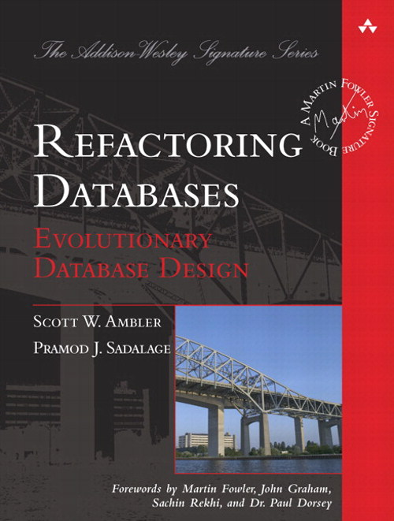
Refactoring Databases Book
Notes:
This is the idea of gradually changing your database design as you learn requirements . It fits in well with current programming trends such as Agile and Lean, which emphasize Minimum Viable Product, and experimentation

Slide 3
Refactoring Database
Expand
Convert/copy data and add triggers
Migrate
Remove triggers
Contract
Notes:
Refactoring a database consists of essentially 3 steps: expand, migrate, and contract.

Slide 4
Expand
Add tables
Add columns
Add DEFAULT constraints
Remove UNIQUE, FOREIGN KEY, PRIMARY KEY constraints
Remove CHECK constraints
Notes:
optional

Slide 5
Migrate
Change stored procedures and functions to use new version
Developers change code to use new version
Notes:
The triggers keep the two versions in sync.

Slide 6
Contract
Remove tables
Remove columns
Remove stored procedures, functions
Remove DEFAULT constraints
Add UNIQUE, FOREIGN KEY, PRIMARY KEY constraints
Add CHECK constraints
Notes:
Contract (optional) – the opposite of expand. (Rename instead of drop if you’re really cautious.)

Slide 7
Demo
Notes:
Setup, show OLD table
Show goals of refactor

Slide 8
Lessons Learned
SET RECURSIVE_TRIGGERS OFF/ON
Triggers execute even if table contents doesn’t change
Testing is painful, especially setup, so…
Have a test script
Use version control
Notes:
Lessons learned
Discovered the RECURSIVE_TRIGGER option. By default, It’s off. Learned what happens when it’s on, namely…
Triggers execute even if no rows are changed.
Setting up a test is a lot of work, so have a test script.
-- Lessons learned:
-- 1. Automated unit tests is a good idea: you back up and start all over a lot
-- You need to cover all cases: INSERT/UPDATE; old/new.
-- 2. Because of lesson #1, version control is probably a good idea
-- 3. Changelog table was a good debugging tool
-- 4. Need "WHERE Customer.CustomerId = inserted.CustomerId" clause to keep from
-- from changing every row. Tests probably need to verify all rows.
-- 5. LEFT OUTER JOIN needed, so ISNULL(deleted.column,...) needed in WHERE clauses.
-- Both needed to handle INSERT situation.
-- 6. An UPDATE that changes no rows still invokes the trigger. Without an IF at the
-- top, the trigger will go into infinite recursion. Alternatively, setting the
-- database "ALTER DATABASE Demo1 SET RECURSIVE_TRIGGERS OFF" also works. (OFF
-- is the default setting.)

Slide 9
References
Evolutionary Database Design: http://martinfowler.com/articles/evodb.html
Expand/Contract pattern: http://martinfowler.com/bliki/ParallelChange.html
Refactoring Databases book

Slide 10
Questions?

Slide 11
(Expected screens)
Extra slides in case SQL Server fails during demo.
Snapshot of old query results BEFORE change. (results and messages)
Test results from test script for trigger.
Snapshot of old query results after adding trigger. (results and messages)
Snapshot of new query results with trigger. (results and messages)
Snapshot of new query results after trigger. (results and messages)

